Slide 1
Object Oriented Programming
(SENG6022)
Arba Minch University
Institute of Technology
Faculty of Computing & Software Engineering
Mr. Addisu M. (Asst. Prof)
G2 SE - Regular

Slide 2
Files & Streams
Chapter Five

Slide 3
Outline
01
Overview of Streams and File I/O Classes
02
File and FileDialog objects
03
Object I/O with Object Streams
04
File Management

Slide 4
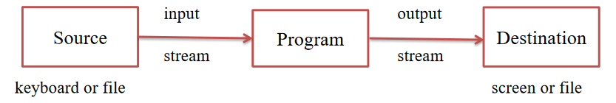
Introduction
I/O = Input/Output
    Input can be from keyboard or a file
    Output can be to display (screen) or a file
java.io package contains all classes required for input and output operations
Advantages of file I/O
    permanent copy
    output from one program can be input to another
    input can be automated (rather than entered manually)
Streams are sequences/flow of data
    support many different kinds of data, including characters, numbers, bytes consisting of binary digits, bytes consisting of binary encoding of objects, etc.

Slide 5
Introduction
Files can be classified as either text or binary
    Human readable files are text files
        Data stored in a text files is represented in human readable form
    All other files are binary files
        Data stored in a binary files is represented in binary form
Java provides many classes for performing text I/O and binary I/O
It uses the concept of stream to make I/O operation fast
In order to perform I/O, you need to create objects using appropriate Java I/O classes
    objects contain the methods for reading/writing data from/to a file

Slide 6
Introduction
Text files: bits represent printable characters
    a file can be created and/or opened by text editor (Notepad) and read by humans easily
    Everything in the file is character form. We can think of the file as one long string, even if it is organized into lines.
Binary files: bits represented in binary form, such as executable instructions or numeric data
    Cannot be directly or conveniently viewed or edited by humans
For Example
Java source programs are stored in text files and can be read by a text editor, but Java .class files are stored in binary files and are read by JVM (Java Virtual Machine) on any machine

Slide 7
Introduction
Advantage of binary files are more efficient to process than text files, because
    Binary file I/O does not require encoding & decoding, but
    Text file I/O requires encoding and decoding
    E.g., number 123 is smaller in binary than in text: "123"
Text file consists of a sequence of characters
    E.g:, decimal integer 199 is stored as sequence of 3 characters: '1', '9', '9' in text file
    Java is UTF-16, that is uses 2 bytes variable encoding for characters
    '1', '9', '9' would require 6 bytes to encode it
Binary file consists of a sequence of bits
    E.g, decimal integer 199 is stored as one byte binary value for the hexadecimal number C7 in a binary file, because the decimal 199 equals to the hexadecimal C7

Slide 8
File Operations
java.io.File is the central class that works with files and directories
instance of this class represents
    name of a file or directory on the host file system
When a File object is created, the system doesn't check to the existence of a corresponding file/directory
If the file exists, a program can examine its attributes and perform various operations on the file, such as renaming it, deleting it, reading from or writing to it

Slide 9
File Operations
File Constructors
Constructor | Description
File(File parent, String child) | creates a new File instance from a parent abstract pathname and a child pathname string
File(String pathname) | creates a new File instance by converting the given pathname string into an abstract pathname
File(String parent, String child) | creates a new File instance from a parent pathname string and a child pathname string
File(URI uri) | creates a new File instance by converting the given file: URI into an abstract pathname

Slide 10
File Operations
Modifier and Type | Method | Description
boolean | createNewFile() | It atomically creates a new, empty file named by this abstract pathname if and only if a file with this name does not yet exist.
boolean | canWrite() | It tests whether the application can modify the file denoted by this abstract pathname.String[]
boolean | canExecute() | It tests whether the application can execute the file denoted by this abstract pathname.
boolean | canRead() | It tests whether the application can read the file denoted by this abstract pathname.
boolean | isDirectory() | It tests whether the file denoted by this abstract pathname is a directory.
boolean | isFile() | It tests whether the file denoted by this abstract pathname is a normal file.
String | getName() | It returns the name of the file or directory denoted by this abstract pathname.
URI | toURI() | It constructs a file: URI that represents this abstract pathname.
File Methods

Slide 11
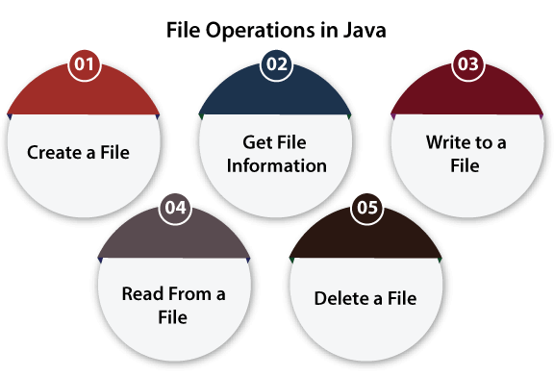
File Operations
We can perform the following operation on a file:

Slide 12
File Operations
Create a File
use createNewFile() method of file - returns
    true when it successfully creates new file and
    false when the file already exists
File f = new File("abc.txt");
    This won’t create any physical file, first it will check the availability of physical file with abc.txt or not
        If it is already available then f pointing to that file
        If it is not available this line won’t create any physical file and just it creates a java file object to represent the name abc.txt

Slide 13
File Operations
import java.io.File;
import java.io.IOException; // class for handling errors
class CreateFile {
public static void main(String args[]) {
try {
File f0 = new File("FileOperationExample.txt");
if (f0.createNewFile()) {
System.out.println(f0.getName() + " is created successfully.");
} else {
System.out.println("File is already exist in the directory.");
}
} catch (IOException ex) {
System.out.println("An unexpected error is occurred.");
ex.printStackTrace();
}
}
}
Create a File

Slide 14
File Operations
Get File Information
use several methods to get the information about the file like name, absolute path, is readable, is writable and length
Description:
    we import java.io.File package
    get the name of the file using getName()
    get the path of file using getAbsolutePath() method of file
    check whether to write data into a file or not using canWrite()
    check whether to read the data of the file or not using canRead()
    get the length of the file by using length()

Slide 15
File Operations
Get File Information
import java.io.File;
class FileInfo {
public static void main(String[] args) {
File f0 = new File("D:FileOperationExample.txt"); // Creating file object
if (f0.exists()) {
System.out.println("The name of the file is: " + f0.getName());
System.out.println("The absolute path of the file is: " + f0.getAbsolutePath();
// Checking whether the file is writable or not
System.out.println("Is file writeable?: " + f0.canWrite());
// Checking whether the file is readable or not
System.out.println("Is file readable " + f0.canRead());
// Getting the length of the file in bytes
System.out.println("The size of the file in bytes is: " + f0.length());
} else {
System.out.println("The file does not exist."); }
}
}

Slide 16
File Operations
Write to a File
use FileWriter class and its write() method together
import java.io.FileWriter;
import java.io.IOException;
class WriteToFile {
public static void main(String[] args) {
  try {
  FileWriter fw = new FileWriter("D:FileOperationExample.txt");
  fw.write(“Writing the content into the File.");
  fw.close();
  System.out.println("Content is successfully wrote to the file.");
  }
  catch (IOException e) {
  System.out.println("Unexpected error occurred");
  e.printStackTrace();
  }
}
}

Slide 17
File Operations
Read from a File
to write data into a file, use the Scanner class
create an instance of Scanner class and use hasNextLine() & nextLine() methods to get data from the file
import java.io.File;
import java.io.FileNotFoundException; // handling errors
import java.util.Scanner; // for reading text files
class ReadFromFile {
public static void main(String[] args) {
try {
File f1 = new File("D:FileOperationExample.txt");
Scanner dataReader = new Scanner(f1);

Slide 18
File Operations
Read from a File
while (dataReader.hasNextLine()) {
String fileData = dataReader.nextLine();
System.out.println(fileData);
}
dataReader.close();
} catch (FileNotFoundException exception) {
System.out.println("Unexcpected error occurred!");
exception.printStackTrace();
}
}
}

Slide 19
File Operations
Delete a File
use delete() method of the file
don’t expected to close the stream using close() method because we neither use FileWriter class nor Scanner class
import java.io.File;
class DeleteFile {
  public static void main(String[] args) {
    File f0 = new File("D:FileOperationExample.txt");
    if (f0.delete()) {
    System.out.println(f0.getName()+ " file is deleted successfully.");
    } else {
    System.out.println("Unexpected error found in deletion of the file.")
    }
  }
}

Slide 20
Directories
Directory – organizing structure of the computer file system
File organization structure is a hierarchical structure involving parent and child relationships just like tree data structures

Slide 21
Directories
Directory – contain a list of other files and directories
    use File object to create directory & list down files available in a directory
Creating Directories
    useful File utility methods – used to create directories
        mkdir() - creates a directory
            returning true on success and false on failure
            Failure indicates that the path specified in the File object already exists, or that the directory cannot be created because the entire path does not exist yet
        mkdirs() - creates both directory and all parents of the directory, including necessary and non-existent parent directories with pathname

Slide 22
Directories
Creating Directories
Example
import java.io.File;
public class CreateDir {
  public static void main(String args[]) {
    String dirname = "D:\\Educational\\Adv Prog";
    File d = new File(dirname); // Create directory now
    if (d.mkdir()) { System.out.println("Directory is created"); }
    else { System.out.println("Directory cannot be created"); }
  }
}

Slide 23
Directories
Listing Directories
    use list( ) method provided by File object to list down all files and directories available in a directory
try {
  File fl = new File(" D:\\Educational");
  if(file.isDirectory()){
    String[] lists = fl.list(); // array of files and directory
    for(String li:lists) {// for each name in the path array
    System.out.println(li); // prints file names
    }
}
}
catch (Exception e) { e.printStackTrace(); // if any error occurs }
    array of file names

Slide 24
Directories
Listing Directories
    use list( ) method provided by File object to list down all files and directories available in a directory
try {
  File fl = new File("D:\\Educational");
  if(file.isDirectory()){
  File[] files = file.listFiles(); // array of file paths
  for(File f:files){// for each name in the path array
    System.out.println(f.getCanonicalPath()); //prints array of pathnames
    }
}
}
catch (Exception e) { e.printStackTrace(); // if any error occurs }
    array of pathnames

Slide 25
Streams
Stream is a sequence of data that is read from source and write to destination
A program uses an input stream to read data from a source, one item at a time
A program uses an output stream to write data to a destination, one item at time

Slide 26
Streams
Standard I/O
All the programming languages provide support for standard I/O where user's program can take input from a keyboard and then produce an output on computer screen
Java provides the following three standard streams:
    Standard Input - used to feed data to user’s program and usually a keyboard is used as standard input stream & represented as System.in.
    Standard Output - used to output the data produced by the user’s program and usually a computer screen is used for standard output stream and represented as System.out
    Standard Error - used to output the error data produced by the user’s program and usually a computer screen is used for standard error stream and represented as System.err

Slide 27
Streams
Standard: Example
import java.io.*;
class Main {
    public static void main(String[] args) {
        System.out.print("Enter your name: ");
        // takes input from keyboard
        String name = System.console().readLine();
        //prints the name
        System.out.println("My name is " + name);
    }
}

Slide 28
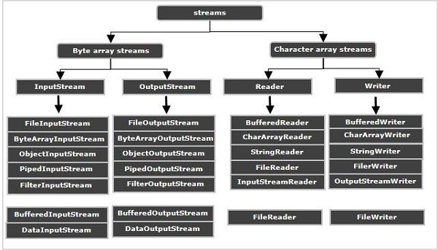
Types of Streams

Slide 29
Types of Streams
Byte Stream: used to read & write single byte (8 bits) of data, can handle any kind of data like Text, Audio, Video, Images etc, further classified into two – root classes
The perspective is the program. (Do not confuse direction as if it's from the file)
    InputStream: used to read data from various input devices like keyboard, file, network, etc
        stream coming from the file into the program
    OutputStream: used to write data to various output devices
        stream going into the file from the program
Character Stream: used to read & write a 16 bit Unicode of data, can handle text data only
    All the character stream classes are derived from base abstract classes Reader and Writer

Slide 30
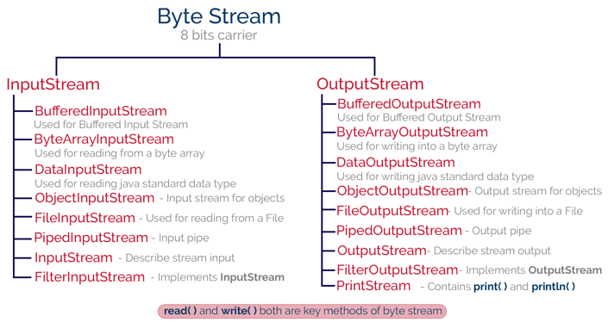
Types of Streams: Byte

Slide 31
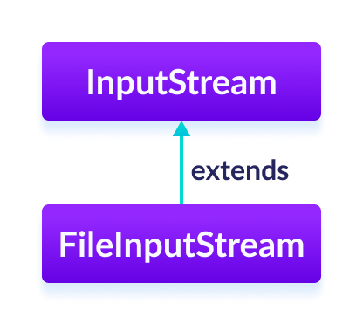
Types of Streams: Byte
InputStream Class
    Since it is an abstract class, it is not useful by itself
        Some of the subclasses can be used to read data: FileInputStream, ByteArrayInputStream & ObjectInputStream
    Create an InputStream
        we must import the java.io.InputStream package first
              // Creates an InputStream
              InputStream object1 = new FileInputStream();
        input stream have bean created using FileInputStream
        It is because InputStream is an abstract class
            Note: We can also create an input stream from other subclasses of InputStream

Slide 32
Types of Streams: Byte
InputStream Class
    Methods - implemented by its subclasses
        read() - reads one byte of data from the input stream
        read(byte[] array) - reads bytes from the stream and stores in the specified array
        available() - returns # of bytes available in the input stream
        close() - to close the file input stream. Once the close() method is called, we cannot use input stream to read data
        finalize() - ensures that the close() method is called
        mark() - marks the position in the input stream up to which data has been read
        reset() - returns the control to the point in the input stream where the mark was set
        …..

Slide 33
Types of Streams: Byte
InputStream Class
    Example: InputStream Using FileInputStream
        Suppose we have a file named input.txt with ff content
        This is a line of text inside the file
available() method
import java.io.FileInputStream;
import java.io.InputStream;
class Main {
    public static void main(String args[]) {
      byte[] array = new byte[100];
      try {
        InputStream input = new FileInputStream("input.txt");
        System.out.println("Available bytes in the file: " + input.available());

Slide 34
Types of Streams: Byte
InputStream Class
    Example: InputStream Using FileInputStream
available() method
        input.read(array); // Read byte from input stream
        System.out.println("Data read from the file: ");
        String dt = new String(array); //Convert byte array into string
        System.out.println(data);
        input.close(); // Close the input stream
      }
      catch (Exception e) { e.getStackTrace(); }
    }
}
Available bytes in the file: 39
Data read from the file:
This is a line of text inside the file
Output

Slide 35
Types of Streams: Byte
FileInputStream Class
    used for reading data (in bytes) from the files
    extends the InputStream abstract class
    Create an FileInputStream
        we must import java.io.FileInputStream package first
        Using the path to file
        Using an object of the file
public class FileInputStream extends InputStream
FileInputStream input = new FileInputStream(stringPath);
FileInputStream input = new FileInputStream(File fileObject);
All methods in FileInputStream are inherited from their superclasses

Slide 36
Types of Streams: Byte
FileInputStream Class
read() method
import java.io.FileInputStream;
public class Main {
    public static void main(String args[]) {
        try {
            FileInputStream input = new FileInputStream("input.txt");
            System.out.println("Data in the file: ");
            int i = input.read(); // Reads the first byte
            while(i != -1) {
              System.out.print((char)i);
              i = input.read(); // Reads next byte from the file
            }
            input.close();
        }
        catch(Exception e) { e.getStackTrace(); }
    }
}

Slide 37
Types of Streams: Byte
OutputStream Class
    Since it is an abstract class, it is not useful by itself
        Some of the subclasses can be used to write data: FileOutputStream, ByteArrayOutputStream & ObjectOutputStream
    Create an OutputStream
        we must import the java.io.InputStream package first
        It is because OutputStream is an abstract class
            Hence we cannot create an object of OutputStream
            Note: We can also create an input stream from other subclasses of OutputStream class
// Creates an OutputStream
OutputStream object = new FileOutputStream();

Slide 38
Types of Streams: Byte
OutputStream Class
    Methods – implemented by its subclasses
        write() - writes the single byte to the file output stream
        write(byte[] array) - writes the bytes from the specified array to the output stream
        write(byte[] array, int start, int length) - writes the number of bytes equal to length to the output stream from an array starting from the position start
        flush() - to clear the output stream – forces the output stream to write all data present in output stream to the destination
        close() - to close the file output stream. Once the method is called, we cannot use the methods of FileOutputStream

Slide 39
Types of Streams: Byte
OutputStream Class
    Example: OutputStream Using FileOutputStream
        Suppose we have a file named input.txt with the ff content
        This is a line of text inside the file
write() method
import java.io.FileOutputStream;
import java.io.OutputStream;
public class Main {
    public static void main(String args[]) {
        String data = "This is a line of text inside the file.";
        try {
          OutputStream out = new FileOutputStream("output.txt");

Slide 40
Types of Streams: Byte
OutputStream Class
    Example: OutputStream Using FileOutputStream
write() method
          // Converts string into bytes
          byte[] dataBytes = data.getBytes();
          out.write(dataBytes); // Writes data to output stream
          System.out.println("Data is written to the file.");
          out.close(); // Closes the output stream
        }
        catch (Exception e) { e.getStackTrace(); }
    }
}

Slide 41
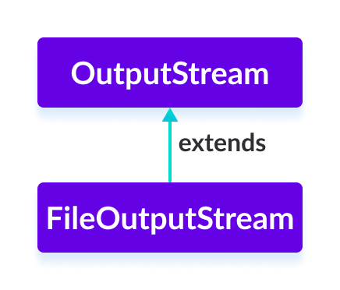
Types of Streams: Byte
FileOutputStream Class
    used to write data (in bytes) to the files
    Syntax
        Using the path to file
          value is an optional boolean parameter
              If it is set to true, new data will be appended to the end of the existing data in the file
              Otherwise, new data overwrites the existing data in the file
        Using an object of the file
FileOutputStream fos = new FileOutputStream(fileName);
//This Syntax will overwrite the contents.
FileOutputStream fos = new FileOutputStream(String path, boolean value);
//This Syntax will append the contents
FileOutputStream output = new FileOutputStream(File fileObject);

Slide 42
Types of Streams: Byte
FileOutputStream Class
write() method
import java.io.*;
class Filecopy{
    public static void main(String[] args)
    throws Exception{
        FileInputStream fis = new FileInputStream(“input.txt”);
        FileOutputStream fos = new FileOutputStream(“output.txt”, true);
        int ch;
        while((ch = fis.read())! = -1){
        fos.write(ch);
        }
        fis.close();
        fos.close();
    }
}

Slide 43
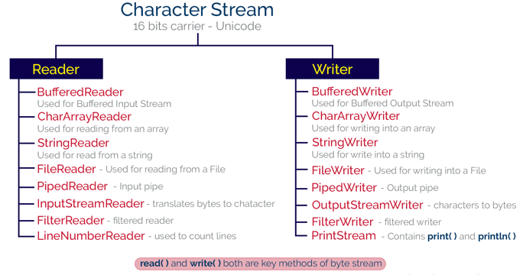
Types of Streams: Character

Slide 44
Types of Streams: Character
Character Stream: used to read & write 16-bit Unicode characters (char by char)/sequence of characters
    can handle only text, also called as Text Streams
    faster than Byte Streams, further classified into two
        Reader: similar to Input Streams performing reading operations from various resources
          Ex: FileReader, BufferedReader
        Writer: similar to output Streams performing writing operations on to various resources
        Ex: FileWriter, PrintWriter
unicode set is a type of character set where each character corresponds to a specific numeric value within the given character set

Slide 45
Types of Streams: Character
Reader Class
    used to read 16-bit characters from input stream
    However, it is an abstract class and can't be instantiated, but there are various subclasses that inherit Reader class and override its methods
    All methods of this class throw an IOException on error conditions

Slide 46
Types of Streams: Character
Reader Class
Class | Description
BufferedReader | provides methods to read characters from buffer
CharArrayReader | provides methods to read characters from char array
FileReader | provides methods to read characters from file
FilterReader | provides methods to read characters from the underlying character input stream
InputStreamReader | provides methods to convert bytes to characters
PipedReader | provides methods to read characters from the connected piped output stream
StringReader | provides methods to read characters from a string
Subclasses of Reader class

Slide 47
Types of Streams: Character
Reader Class
Method | Description
read() | returns the integer representation of the next character present in the input. It returns -1 if the end of the input is encountered
read(char buffer[]) | used to read from the specified buffer. It returns total # of characters successfully read. It returns -1 if the end of input is encountered
mark(int nchars) | used to mark current position in the input stream until nChars characters are read
reset() | used to reset the input pointer to the previous set mark
skip(long nChars) | used to skip the specified nChars characters from the input stream and returns the number of characters skipped
ready() | returns a boolean value true if the next request of input is ready. Otherwise, it returns false
close() | used to close the input stream. However, if the program attempts to access the input, it generates IOException
Methods of Reader class

Slide 48
Types of Streams: Character
FileReader Class
    used to read contents of a file
    Two most commonly used constructors
        FileReader(String filePath) – gets filename in string
        FileReader(File fileObj) – gets filename in file instance
            For both – opens the given file in read mode. If file doesn't exist, it throws FileNotFoundException
FileReader fr=new FileReader("D:\\testout.txt");
int i;
while((i=fr.read())!=-1) {
System.out.print((char)i);
        }
        fr.close();

Slide 49
Types of Streams: Character
BufferedReader Class
    creates buffered character stream between input device & program
    defines methods to read data from the buffer in the form of characters
    BufferedReader object can be created using one of the following two constructors
    Two ways to create BufferedReader object
        BufferedReader(Reader rd) – gets filename in string
        BufferedReader(Reader rd, int size) – gets filename in file instance

Slide 50
Types of Streams: Character
BufferedReader Class
import java.io.*;
public class BufferedReaderExample{
public static void main(String[] args) throws Exception{
FileReader fr = new FileReader("D:\\Educational\\sum.txt");
BufferedReader br = new BufferedReader(fr);
int i;
while (( i = br.read())!=-1){
System.out.print((char)i);
}
}
}

Slide 51
Types of Streams: Character
Writer Class
    throw an IOException in the case of errors
    used to write 16-bit Unicode characters to output stream
    Like Reader, Writer class is also an abstract class that cannot be instantiated; therefore, the subclasses of Writer class are used to write characters onto the output stream

Slide 52
Types of Streams: Character
Writer Class
Class | Description
BufferedWriter | provides methods to write characters to the buffer.
FileWriter | provides methods to write characters to the file.
CharArrayWriter | provides methods to write the characters to the character array.
OutpuStreamWriter | provides methods to convert from bytes to characters.
StringWriter | provides methods to write the characters to the string
PrintWriter | Output Stream that contain print() and println() method.
Subclasses of Writer class

Slide 53
Types of Streams: Character
Writer Class
Method | Description
write() | used to write the data to the output stream.
write(int i) | used to write a single character to the output stream.
write(char buffer[]) | used to write the array of characters to the output stream.
write(char buffer [],int loc, int nChars) | used to write the nChars characters to the character array from the specified location.
close () | used to close the output stream. However, this generates the IOException if an attempt is made to write to the output stream after closing the stream.
flush () | used to flush the output stream and writes the waiting buffered characters.
Methods of Writer class

Slide 54
Types of Streams: Character
FileWriter Class
    Creates a Writer that you can use to write to a file
    Its most commonly used constructors are
        FileWriter(String filePath)
        FileWriter(String filePath, boolean append)
        FileWriter(String fileObj)
        FileWriter(String fileObj, boolean append)
    They throw an IOException

Slide 55
Types of Streams: Character
FileWriter Class
import java.io.*;
class FileWriterDemo{
    public static void main(String[] args)
    throws Exception{
        Striing source = “This is FileWriter demo”;
        FileWriter fw0 = new FileWriter(“file1.txt”);
        fw0.write(source);

Slide 56
Exception Handling with File I/O
Catching IOExceptions
IOException is a predefined class
File I/O might throw an IOException
catch the exception in a catch block that at least prints an error message and ends the program
FileNotFoundException is derived from IOException
    any catch block that catches IOExceptions also catches FileNotFoundExceptions
    put the more specific one first (the derived one) so it catches specifically file-not-found exceptions
    then you will know that an I/O error is something other than file-not-found

Slide 57
Exception Handling with File I/O
Example: Reading File Name from Keyboard
public static void main(String[] args)
{
String fileName = null; // outside try block, can be used in catch
try
{
Scanner keyboard = new Scanner(System.in);
System.out.println("Enter file name:");
fileName = keyboard.next();
BufferedReader inputStream =
new BufferedReader(new FileReader(fileName));
String line = null;
line = inputStream.readLine();
System.out.println("The first line in" + filename + " is:");
using file name read from the keyboard
reading file name from keyboard
reading data from the file

Slide 58
Exception Handling with File I/O
Example: Reading File Name from Keyboard
System.out.println(line);
// . . . code for reading second line not shown here . . .
inputStream.close();
}
catch(FileNotFoundException e)
{
System.out.println("File " + filename + " not found.");
}
catch(IOException e)
{
System.out.println("Error reading from file " + fileName);
}
}
closing the file

Slide 59
Exception Handling with File I/O
Exception.getMessage()
  to get detailed message of the error
  try
  {
  …
  }
  catch (FileNotFoundException e)
  {
  System.out.println(filename + “ not found”);
  System.out.println(“Exception: “ + e.getMessage());
  }

Slide 60
Input/Output Streams
Streams represent the flow of data and that data can be in any format (byte, text, primitive data type, etc)
To write data into a destination, the output stream is used and in order to read the data, the input stream is used
Input/output can be read/write as the following different formats:
#1) Reading File As Byte Stream
data will be read in byte format
  “FileInputStream” and “FileOutputStream” classes are used for reading the content as a byte

Slide 61
Input/Output Streams
#1) Reading File As Byte Stream
import java.io.*;
import java.io.IOException;
public class ByteStreamsDemo {
  public static void main(String[] args) throws IOException {
    FileInputStream fin =null;
    FileOutputStream fout =null;
    try {
      fin=new FileInputStream("input.txt");
      fout=new FileOutputStream("out.txt");
      int c;
      while((c=fin.read() )!= -1){
      fout.write(c);
      }
} catch (FileNotFoundException e) {
    e.printStackTrace();
    }
catch (IOException e) {
    e.printStackTrace();
    }
    finally {
      if(fin!=null) {
      fin.close();
      }if(fout!=null) {
      fout.close();
      }
      }
  }
}

Slide 62
Input/Output Streams
#2) Reading File As Character Stream
input stream will be read in character format
FileReader and FileWriter classes are useful for reading
public class CharStreamDemo {
  public static void main(String[] args) throws IOException {
    FileReader input = null;
    FileWriter output = null;
    try {
      input = new FileReader("input.txt");
      output = new FileWriter("out1.txt");
      int c;
      while ((c = input.read()) != -1) {
      output.write(c);
      }
    }
    finally {
      if (input != null) {
      input.close();
      }
      if (output != null) {
      output.close();
      }
    }
  }
}

Slide 63
THANKS!
Questions, Ambiguities, Doubts, … ???

